Slide 1


Slide 2

Wholly owned properties
300 Allstate Headquarters
180 East Beaver Creek
222 Sheppard Avenue
North Vancouver Office
Data Centre facilities:
Main Data Centre at 300 Allstate HQ
Backup DC in Montréal
151 Front Street
Hubs in
New York
Chicago
LA
London
Paris
Istanbul
… and follow the sun back to North America
Dubai
Tel Aviv
Singapore
Hong Kong
Sydney
A Global
footprint

Slide 3
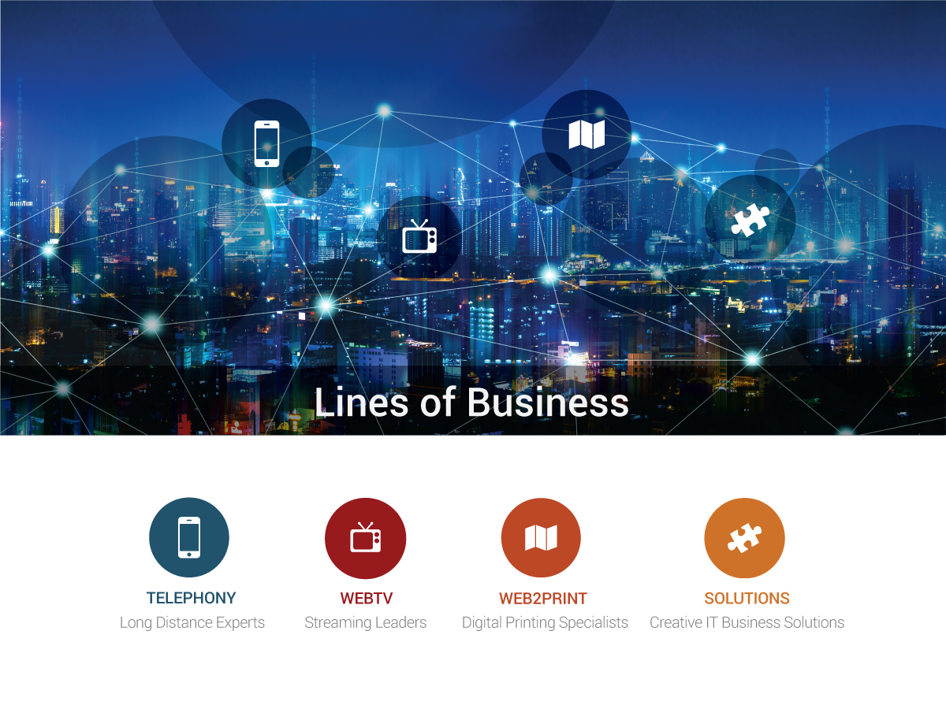
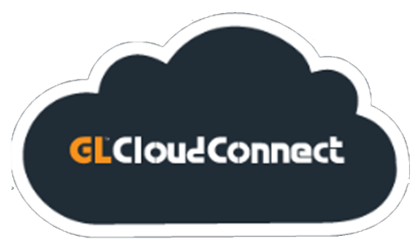

Slide 4


Slide 5

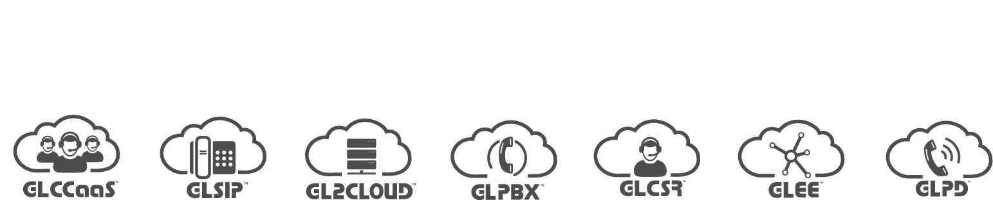
Contact Centre
as a Service
Burstable
Trunking
UC
Solutions
Predictive
Dialer
Customer
Service
Rep
Data Center
Services

Slide 6
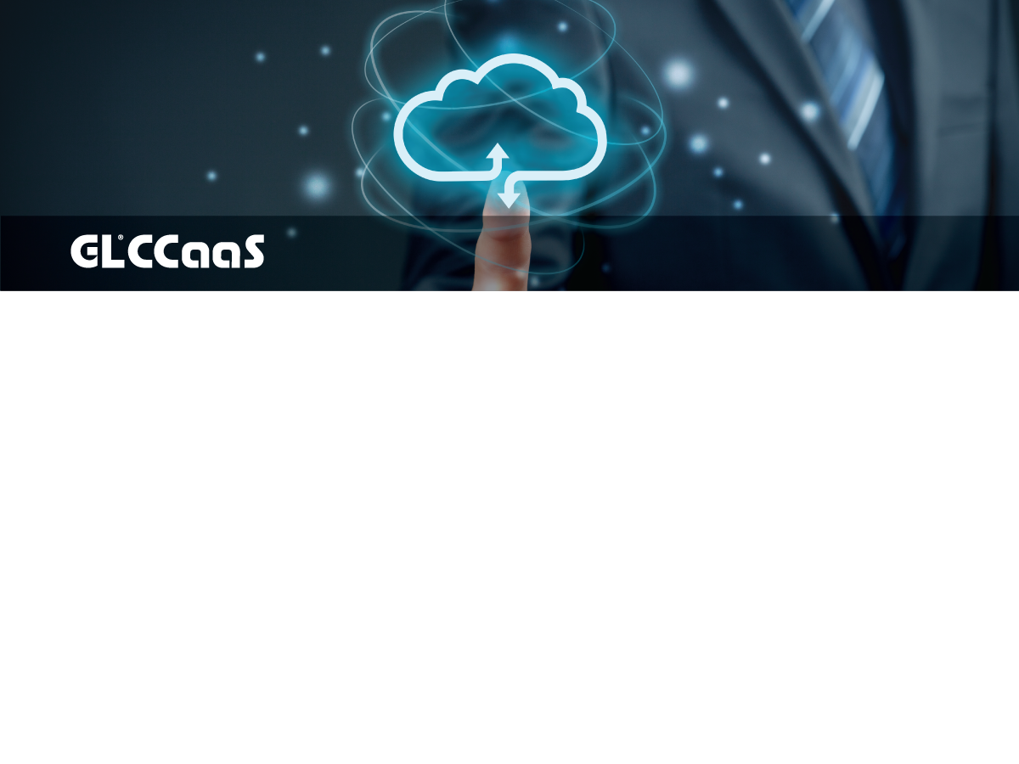
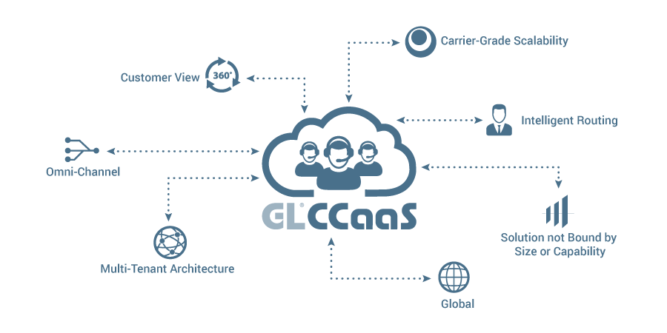

Slide 7
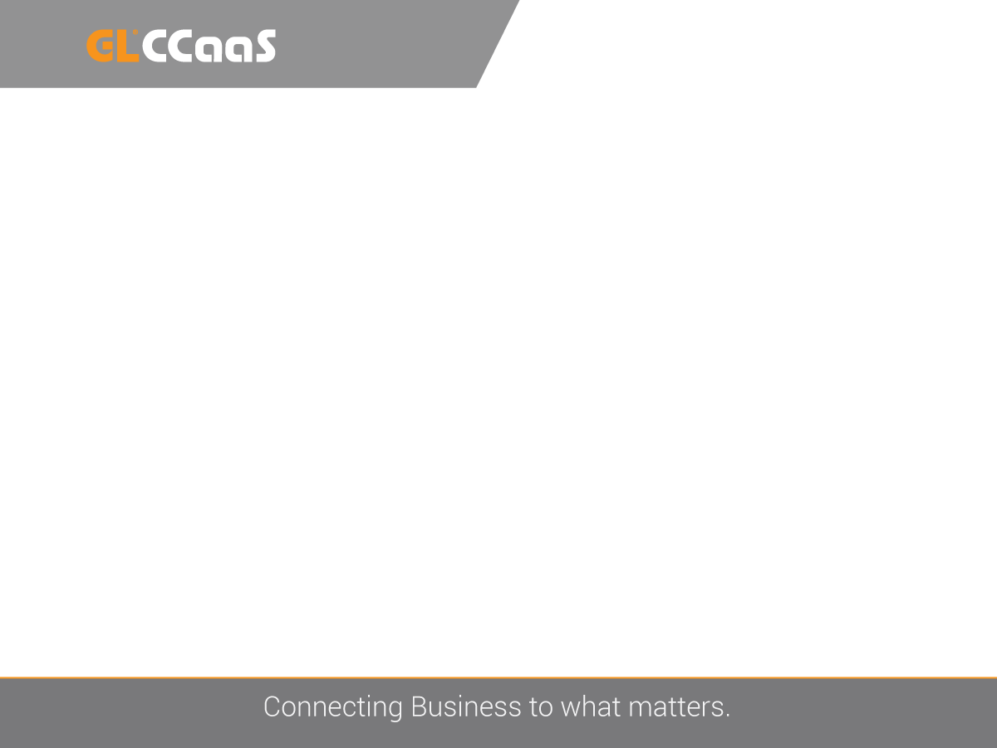
GLCCaaS Addresses Business Drivers
Cloud contact center address business agility requirements
  Flexibility
  Reduce IT Burden
  CAPEX reductions

Slide 8
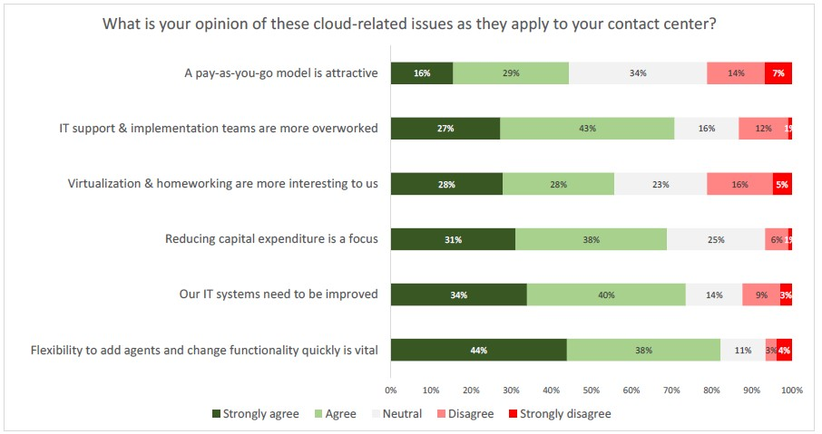
Source: Contact Babel ‘The Inner Circle Guide to Cloud-Based Contact Center Solutions’ 2nd Edition 2015

Slide 9
Growth is in Cloud Contact Center
Worldwide hosted agent positions are calculated to grow at 17.6% CAGR, significantly more rapidly than on-premise positions which are predicted to grow at 0.5% CAGR through 2018.
All major regions will see between15-19% growth in host agent seats with hosted seat growth at 23% for South and Central America.

Slide 10









Source: Ovum, Global Contact Center Technology Spending Forecast: 2013–18
Worldwide Hosted vs On-premise CAGR
25.0%
20.0%
15.0%
10.0%
5.0%
0.0%
-5.0%
2015
Hosted
2016 2017
Premises-based Total
2018

Slide 11
End-Customer Business Case
Contact Center as a Service offers key benefits:
  Reliability Always available, built in business continuity,
  no hidden costs
  Flexibility Add agents, new channels and features
  easily and quickly
  Access Agents anywhere, need a multi-media PC
  and internet connection
  Commercials OPEX model, pay as you use, scaling up and down
  Economics Hugely reduced infrastructure footprint and IT overhead
  Proven Business leaders are increasingly interested in
  the as-a-Service application model and the agility benefits provided

Slide 12
The Service Provider Opportunity
Bundled Solutions for the Contact Center
Seamless Cloud models (Public, Community, and Hybrid)
Superior Network Uptime and Service Capabilities

Slide 13
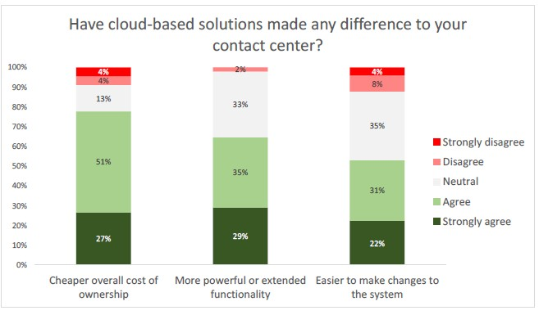
GLCCaaS Making a Difference

Slide 14
Contact Center Service Provider
WHY PARTNER WITH GLCloudConnect?

Slide 15

A Global Footprint
HQ in Toronto, Canada
Service Providers in USA, Mexico, Canada, UK, EU, Middle East, Japan, Philippines and India

Slide 16
MULTI-CHANNEL CONTACT CENTER
Contact Center Enterprise · Contact Center Service Provider · Communications Center with Skype for Business · Contact Center On-Demand · Outbound Dialer
ATTENDANT/OPERATOR CONSOLE
Intuition Attendant Console (Avaya/Genband) · Arc Pro Attendant Console for CISCO · Operator Console for Microsoft Skype for Business
ANDTEK Console
SELF-SERVICE
Communication Portal · Knowledge Management Suite
QUALITY MANAGEMENT
Call Billing and Reporting Enterprise & Cloud · Call & Computer Recording · Agent Evaluation · Quality Management Suite · Workforce Management System
Leading solutions to maximize the value of customer interaction

Slide 17

GLCCaaS Platform Overview

Slide 18
Contact Center Service Provider
GLCCaaS is a highly scalable, carrier-grade, multi-tenant, multi-channel Contact Center as a Service (CCaaS) application designed as a service delivery platform for cloud based deployments.

Slide 19







Contact Center Service Provider
Public Cloud
Hybrid Cloud
Community Cloud

Slide 20
Why Multi-Tenancy?
Economies of Scale (cost savings)
  Better utilization of shared resources such as hardware and databases
  Single point of administration and operational expertise
  One large system often cheaper than equivalent 10 smaller systems
Higher Scalability and Reliability
  Large scale deployments can offer n+1 resilience to end users
  Shared resources enable flexible up and down scaling in capacity
  Carrier grade operational and monitoring on 24 x 7 basis provided
Self Control to the Individual Tenant
  Individual tenants have full control over their own configuration and settings
  Virtual partitioning enable individual tenants to operate autonomously
  Limited skills and resources needed to operate ‘own’ software

Slide 21
GLCCaaS Product Strategy
Be the preferred platform for service providers to deliver contact center services to their customers based on:
Reliability, scalability and operational management
Total cost of ownership of delivering contact center services
  Multi tenant platform with shared resources
  Lowest operational costs with tenant self administration
Adaptability and integrations
  Full open interfaces for standard, flexible and easy integrations
  Customizable to service provider and end-customer requirements
Customer Interaction capabilities
  Rich multi media interaction routing and self services
  Enhanced functionality and features

Slide 22
Service Provider Features & Benefits
Increase operational efficiency with secure, multi-tenant
cloud platform
Secure partitioning of shared resources enables public or community cloud and better utilization of shared resources
Decide what level of control your individual tenants have and empower users to manage their own contact center partition(s)
Simplify provisioning, management, and administration Integrated voice switching capabilities without the need for separate telephony or voice infrastructure
Lowest total cost of ownership

Slide 23
Service Provider Features & Benefits
Support mission critical operations with scalability and reliability
Platform created with carrier-grade reliability in mind, “Telco tested”
Highly scalable to thousands of agents - increase capacity by adding servers
Cloud model enables business continuity and disaster recovery (n+1 resilience to end users)
Flexible platform allows for limitless potential in integrating existing Service Provider offerings

Slide 24
End Customer Features & Benefits
Tailor your GLCCaaS solution to suit your customer’s business Inherent location independence lets contact centers manage and report on agents/supervisors anywhere
Customer only pays for what they need, scaling up and down Configurable and customizable web-accessible agent desktop
Offer a rich set of multi channel, IVR and routing capabilities that might otherwise be cost prohibitive
Flexible platform simplifies integration with CRM and business apps for better customer experiences
Business agility with cloud contact center

Slide 25
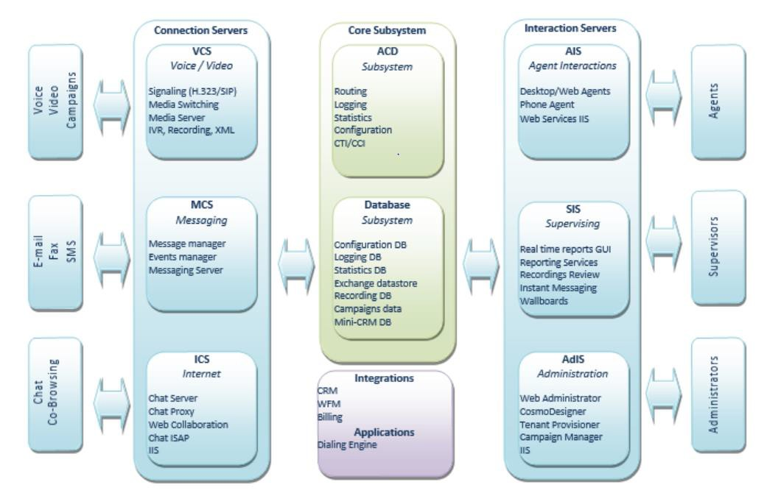
GLCCaaS Architecture

Slide 26


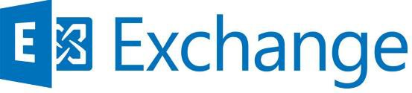
GLCCaaS and Microsoft Technology
Microsoft technology support
Microsoft Windows Server 2012 R2 support
Microsoft SQL Server 2012 SP2 support
Microsoft Active Directory 2012 R2 support
Microsoft Exchange 2010

Slide 27

GLCCaaS Feature Highlights

Slide 28

GLCCaaS Key Capabilities
Intelligent Multi-channel Routing
Universal queue for all media types (Voice, Email, Chat, Social, Video)
Voice Switching Capabilities
Built in soft phone, IP desk phone, Skype for Business Integration
Integrated Self-Service
Interactive Voice Response (IVR)
Graphical scripting tool for IVR and routing scripts
Web Accessible Interfaces
Agent, Supervisor and Administrative
Supports Single Sign-on

Slide 29



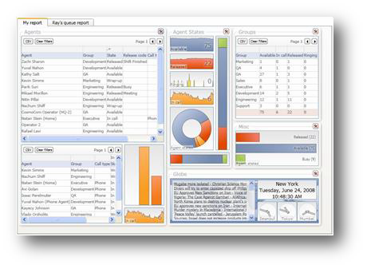
GLCCaaS Key Capabilities
Outbound Dialer
List-based preview, progressive and predictive dialing modes
Recording and Quality Monitoring
Multimedia recording (phone, email, chat) allows storage and access of interactions regardless of contact type
Real-time and Historical Reporting
real-time and historical reporting of all contact center activities, including queues, skills, groups, and more from any location

Slide 30
Intelligent Multi-channel Routing
One point of queuing and routing for all contact types
  Phone calls
  Videophone calls
  Emails
  Voicemail
  Web chat
  Social
  Web voice
All contact types are tracked and managed through one database and one set of real-time and historical rules

Slide 31
Voice Switching Capabilities
GLCCaaS provides voice switching features and operates independent of third party voice systems
Voice soft-client or IP phone
Self provisioning allows each tenant to distribute
allocated extensions across users
PBX feature set
Dialing Plan
Voicemail

Slide 32



Skype for Business Integration
Client based integration utilizing the new TouchPoint Connector to exchange presence information and provide easy back office integration
User scenarios:
GLCCaaS Agent presence synchronization with Skype4B
GLCCaaS Agent seeing back office specialists presence
GLCCaaS Agent transfer/conference call to back office specialist
GLCCaaS Agent using Skype4B phone as alternative device
Skype for Business + GLCCaaS =
Increased Collaboration
across the enterprise

Slide 33
Integrated Self-Service
A browser-based graphical tool for call flow generation and IVR service creation
General Logic
ACD Logic
Routing, Queuing and distribution logic for all media
  Voice, Voicemail, Email, Chat
Announcements
Music on Hold
Speech integration

Slide 34
TouchPoint Client
Web based (HTML 5) application
  Minimal footprint and installation privileges
  IE, Chrome, Firefox
Screen footprint is flexible
  Collapse to sidebar
  Ability to easily work with two monitors
Full two-way client side integration
  Based on “Gadget” and “Notifications” technology
  Reduce the cost and the complexity of integrations
Customization on many levels
  Tenant / Group / Team / Role
Clear and updated UI and User Experience
  Intuitive application with short learning curve
Automatic Updates (Policy Driven, Faster Response)

Slide 35
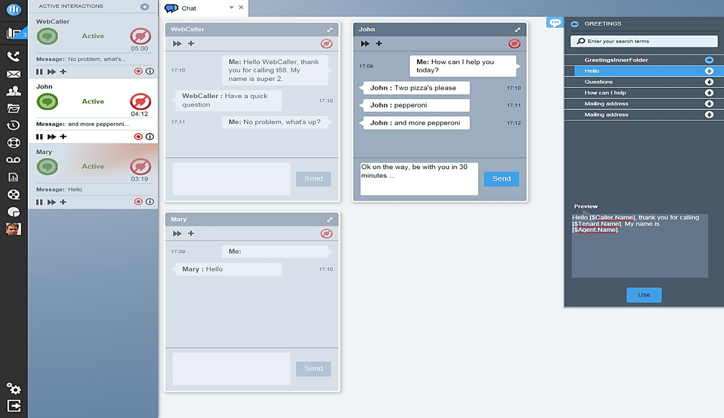

TouchPoint Agent
Modern, intuitive interface with feature rich capabilities makes everyone’s job easier.

Slide 36
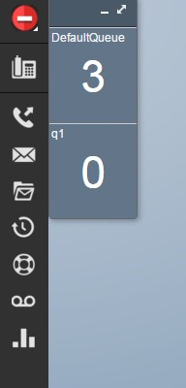
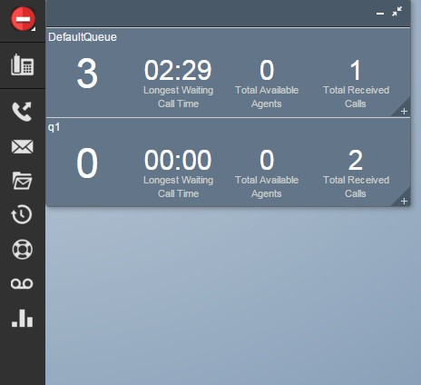
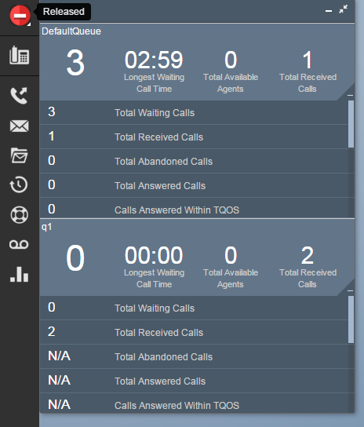
Mini Wall Board

Slide 37
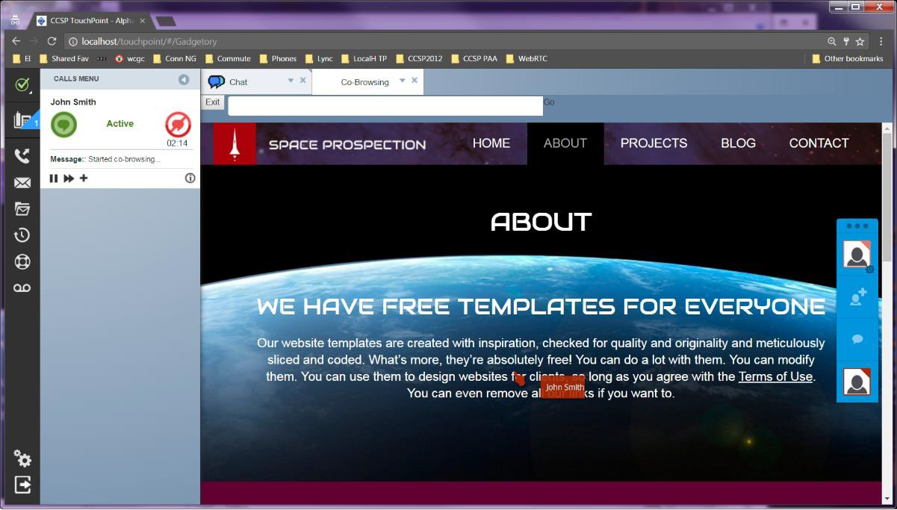
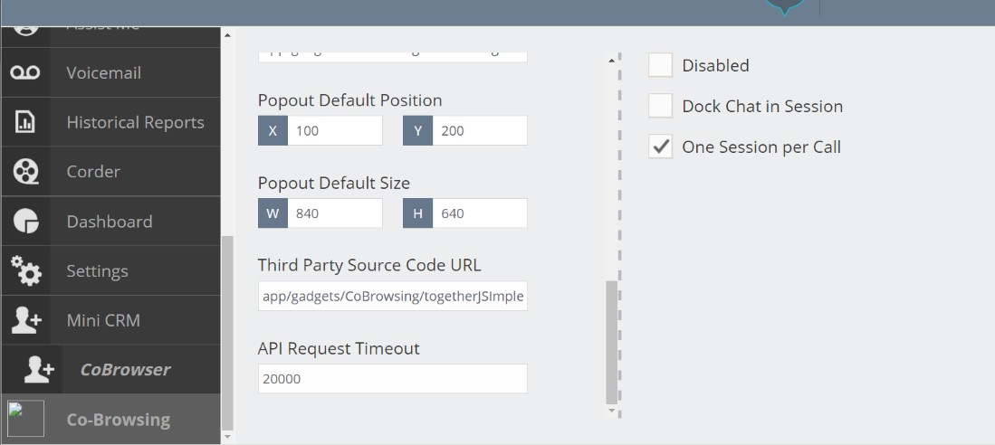
Co-Browsing Enablement
Leverages the TouchPoint Chat Gadget for standard integration
Extends the API to link into third-party co- browsing solutions
Can be configured through AdminPoint
GLCCaaS also provides a native, basic co- browsing option on the same API interface based on TogetherJS

Slide 38
Outbound Dialer
Includes comprehensive answering machine and tone detection capabilities, and the ability to leave messages
Dialing modes include
Preview dialing (review target info and confirm call placement before each call)
Progressive dialing (review information as the call is being dialed)
Predictive dialing (sophisticated algorithms are used to dynamically control dialing rate and increase user productivity)
IVR dialing (successful out dials are routed to an IVR script)

Slide 39
Recording and Quality Monitoring
Multimedia recording allows users to store and access all caller/user interactions regardless of contact type (phone, email, chat, etc.)
To improve the effectiveness of quality monitoring, calls can be recorded selectively based on a variety of factors such as user, group, skill, etc.
All calls can be recorded to meet legal compliance or other requirements.
All recorded customer contacts are stored in a database, and a web-based interface is used to find and review any recording.
GLCCaaS also provides at will recording and user screen recording.

Slide 40
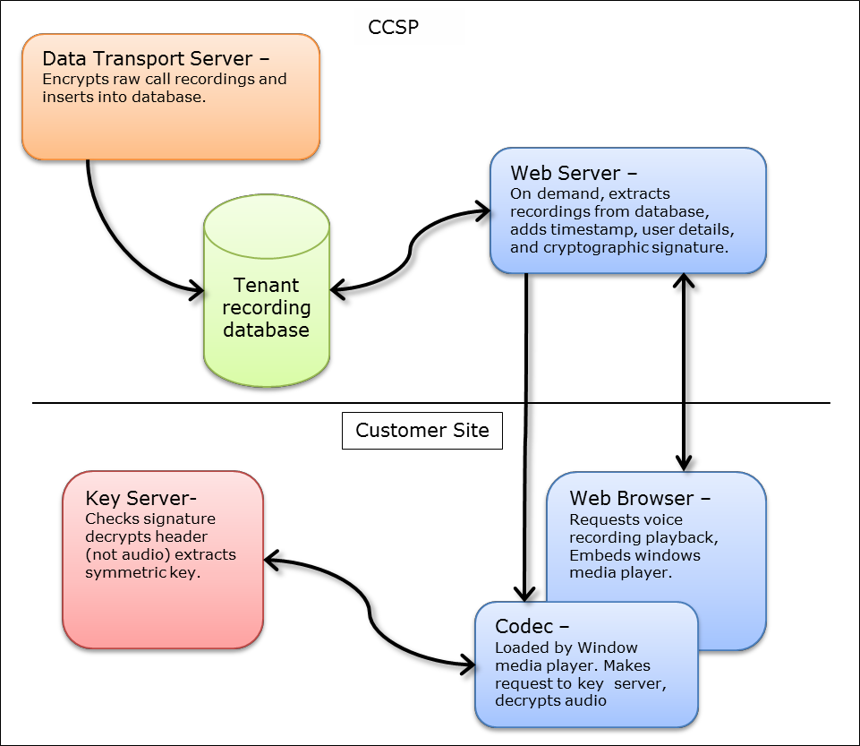
Recording Encryption
Recordings are encrypted before being stored in database
Provides tenant specific encryption key security Encrypting call recordings
can be part of a larger program for facilitating PCI compliance when recording credit card transactions

Slide 41

GLCCaaS
Reporting &
Analytics

Slide 42
Real-time and Historical Reporting
A browser-based interface real-time and historical reporting of all contact center activities, including queues, skills, groups, and more from any location.
Open database, ability create custom reports using standard report generation tools or business analysis applications
Analyst: Automatically creates and maintains an Online Analytical Processing (OLAP) cube data model
  aggregated contact center statistics and measures
  instant customized report generation by end users through either Microsoft report builder or Excel pivot tables.

Slide 43
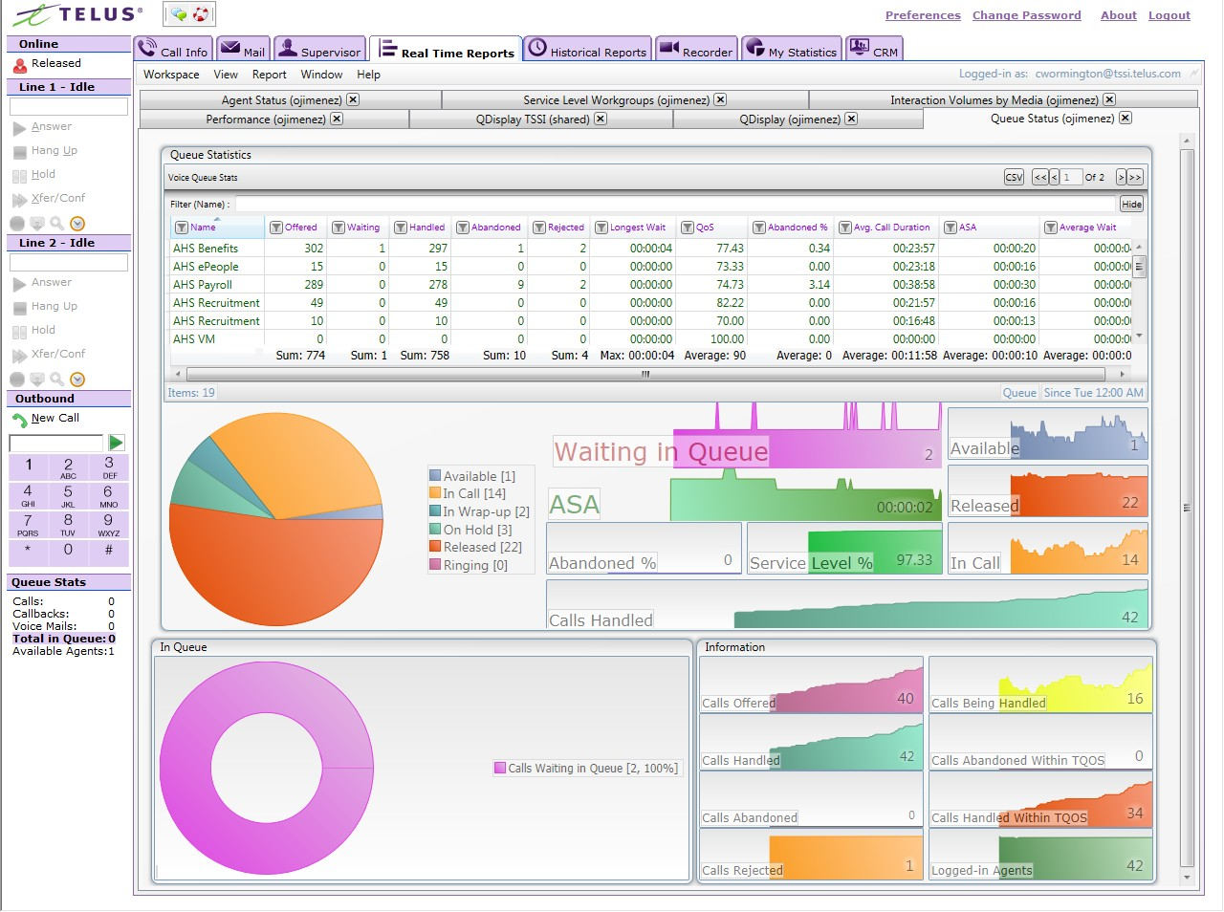
Real Time Monitoring Dashboard

Slide 44
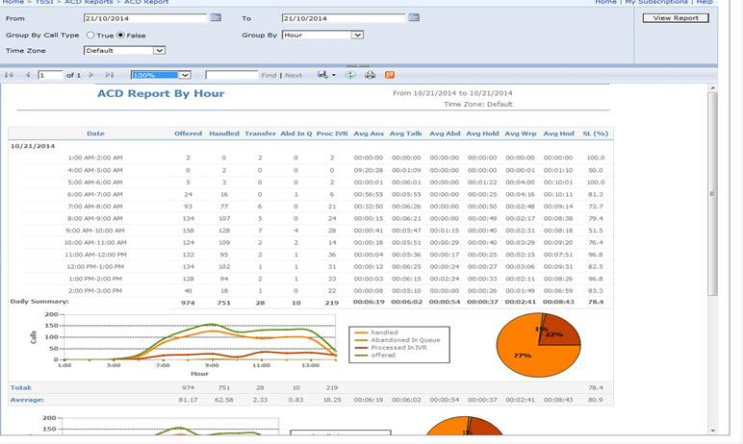
Historical Reporting

Slide 45
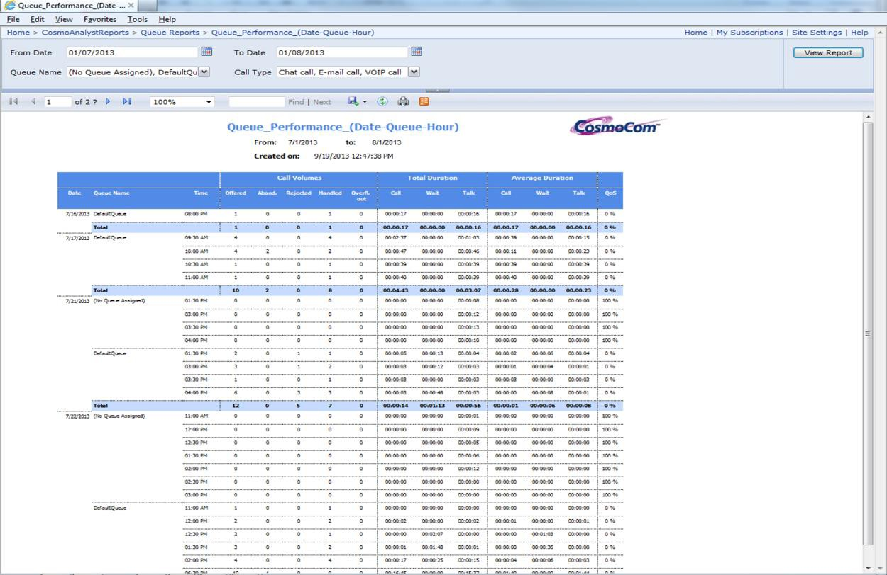
Analyst
Non-technical users can create and customize reports
Robust time hierarchy (Intervals of 15 minutes to years)
Can use built-in Microsoft Report Builder or Excel for Pivot table analysis

Slide 46
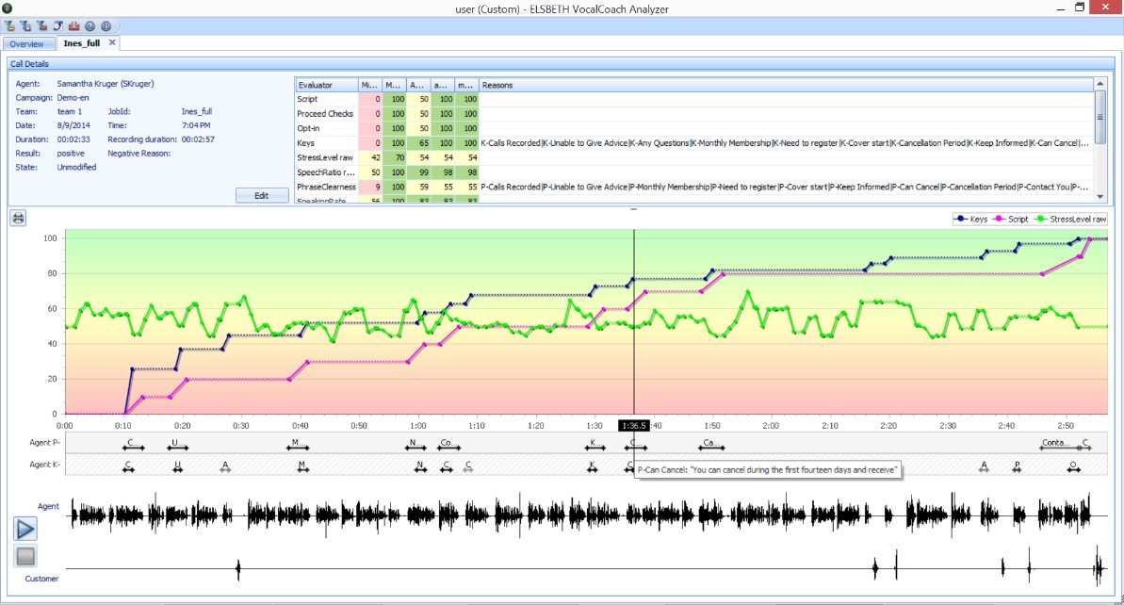


Speech Analytics (Batch Mode Integration)
Supervisors can review recorded Agent calls, hold trainings, and improve customer service.
Integrates GLCCaaS Call Recording to Enghouse Interactive IT Sonix
Use Optional parameter to select calls in scripts for VC analysis
Files are exported to the Vocal Coach file server for easy access and storage
Vocal Coaching & Speech Analytics give agents and supervisors the tools to be better.

Slide 47

GLCCaaS
Connectors &
Add-Ons

Slide 48

Social Media Connector for GLCCaaS
Extend your offered contact channels with social messaging
  Based on GLCCaaS Chat API
  Social Connector Service supports N+1 and Plugin architecture
  Same Agent experience as TouchPoint Web Chat – no learning new tool
  Tenant’s customers contact them using messaging apps they already use
    Facebook Messenger
    Twitter
    Skype or Skype for Business
    Slack
    GroupMe
    Microsoft Teams
    Text / SMS (Twillio)

Slide 49
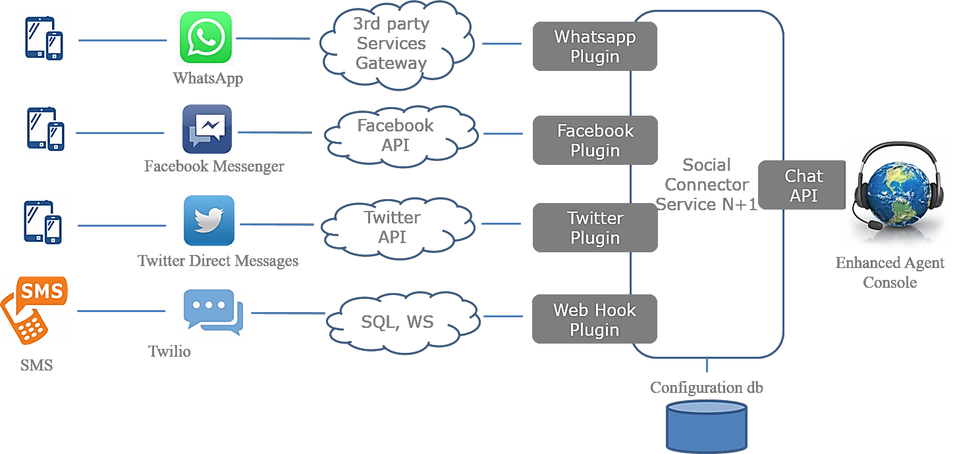
Social Media Connector Architecture
Connector extends Web Chat
features to include
Social Information
Message Copy
Use of Emoji
Ability to upload image or document
Allows contact blocking
With CRM integration provides CRM popup on social message

Slide 50
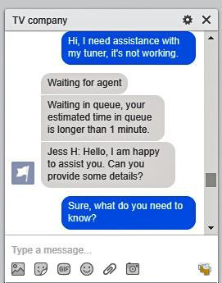
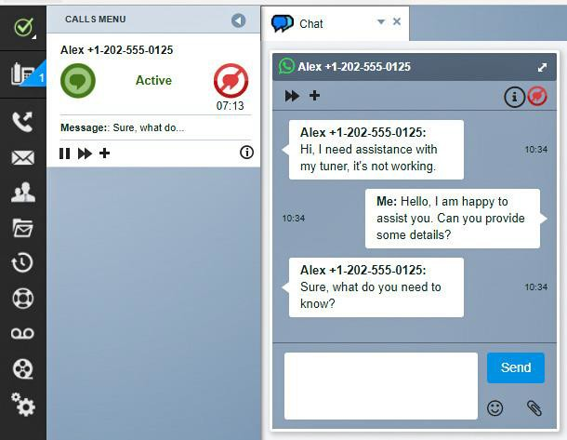
Social Media Connector Example
Customer uses Facebook Messenger to send a Message
GLCCaaS Agent uses Touchpoint
to chat with customer

Slide 51
Salesforce Connector for GLCCaaS
Extend your cloud contact center offer by offering integration to Salesforce CRM
Benefits for the Service Provider
Generate additional revenue with CRM license and services
Faster deployment of Salesforce integration
Configurable framework for Screen Pop searches
Benefits for the Tenant
Service Provider offers quick integration into Salesforce CRM
Improved customer experience and no more repeating of customer information
Higher agent productivity as screen pops and call & data transfer reduce call length

Slide 52
Salesforce Connector Features
Screen Pop directly to customer inform– saves time and avoid repeating!
  Searches Salesforce on GLCCaaS call and caller entered digits automating CRM record search
  Agents can personalize interaction
  Call data tied to CRM interaction data for a complete customer history
Click to Dial
  Click phone number in contact detail to automatically place outbound call
Contextual Call and Data transfer means customers never repeat what they’ve entered and what they’ve already told the first agent
  Receiving agent receives the transfer call as well as notes attached to the call record
GLCCaaS Web Chat will initiate a Screen Pop for the Salesforce account based on Caller Name
Salesforce Email can be forwarded to GLCCaaS for routing, distribution and response
  Email is stored in Salesforce
  Once agent answers email application data on email is passed from GLCCaaS to Salesforce

Slide 53













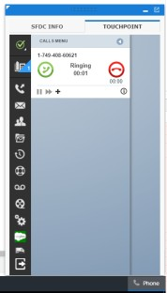
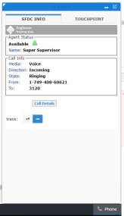
Salesforce Connector Architecture
Integration uses standard Salesforce Open CTI interface
Server side integration from Sales force to GLCCaaS
Open CTI is Java script
running from client
Salesforce.com
Hosting GLCCaaS Environment
Salesforce Connector N+1
AIS
Agent Desktop embedded in SFDC
Touch Point
Salesforce OpenCti
Softphone
Open CTI Https

Slide 54
Salesforce Events notification
The Salesforce Connector integrates the Salesforce event notifications for:
Call Disconnected
Established Inbound
Established Outbound
Held/Retrieved
Call Conferenced
Call Transferred
Wrap up
Salesforce user is configured with an extension
that maps to the GLCCaaS Agent ID enabling Single Sign-on.

Slide 55
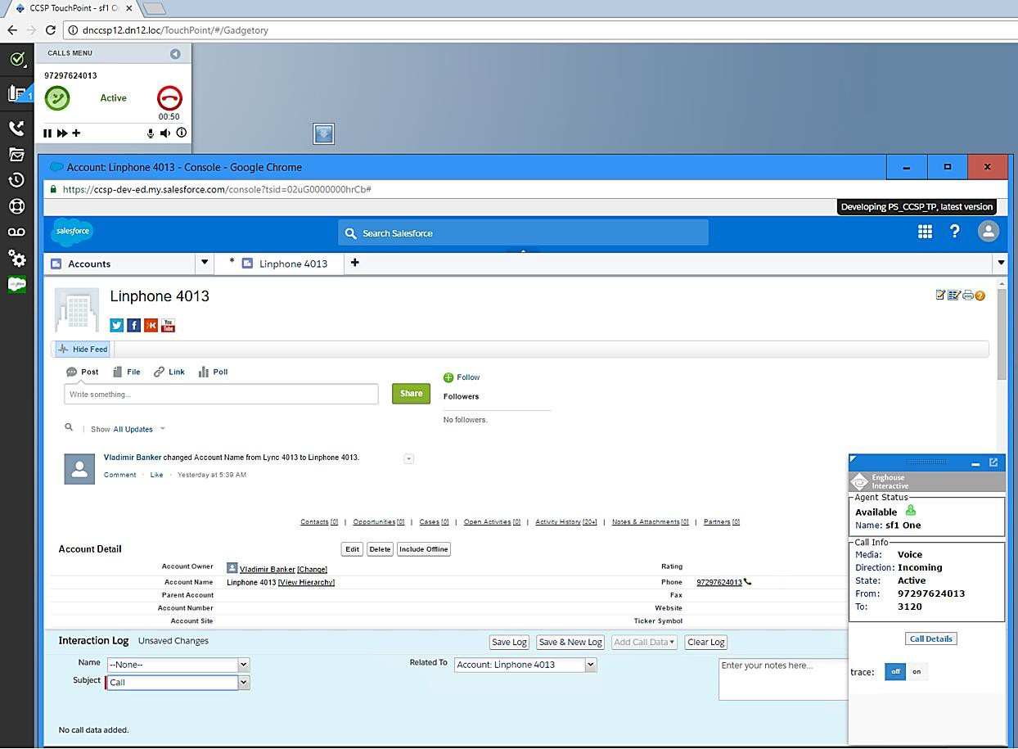
Salesforce Connector Example
OPTIONS:
Touchpoint can also be embedded in Salesforce with event notifications via the server.
Hybrid mode – Salesforce and Touchpoint side by side is also supported.
Salesforce Console mode - Salesforce is full screen
with an Enghouse provided Open CTI based softphone

Slide 56

GLCCaaS
Administration &
Integration

Slide 57
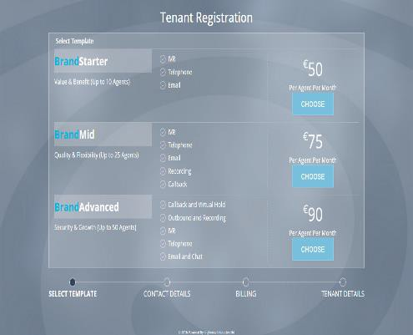
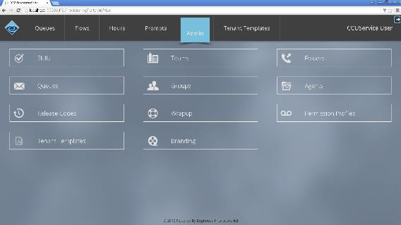
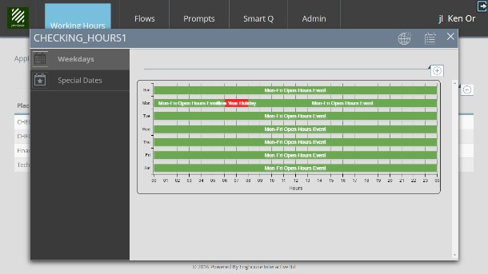
Provisioning Portal
Web accessible tenant provisioning portal
On-board new tenants more easily and quickly
  – Tenant templates automate new tenant creation
Extend Portal to web for new tenant registration and creation
Existing tenants utilize Portal as contact center management tool
  Agent management, skills
  Call Flows, Queues, Groups
  Prompts, Prompt Library and Call Treatments
  Calendar / Working Hours

Slide 58
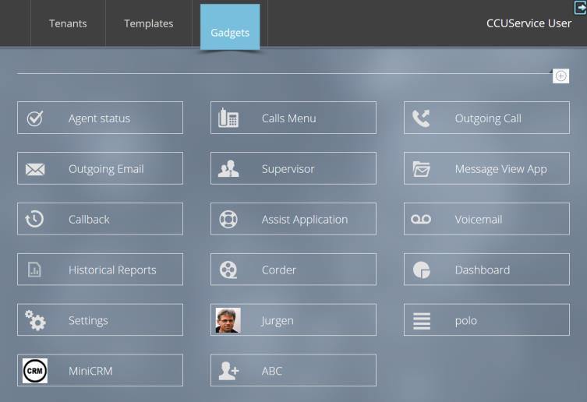
TouchPoint Admin Point
Administration area for TouchPoint configuration and customizations
Landlord and Tenant level Manage TouchPoint Gadgetory
  List of available gadgets
  Look and feel of gadgets
  Add, change, delete gadgets (Tenant, Group, and Roles overrides for specific gadgets)
Use of templates
Options to duplicate and edit

Slide 59
GLCCaaS Gadgetry
Simple, easy to use library for managing gadget activation and placement
  Configurable UI components
  Gadgets provide UI access to features and communication channels
Integration framework – create custom gadgets
  Makes the user interface extensible
Delivered Gadgets:
Agent Status
Calls Menu
Outgoing Call
Outgoing Email
Supervisor
Message View App
Callback
Assist Application
Voicemail
Historical Reports
Corder recording
Dashboard
Settings

Slide 60
Web Admin
GLCCaaS Landlord (service provider) system tenant management
  System-wide administration, server resources and platform settings
  Dialing Plan, Telco and DNIS assignment, outbound dial privileges
  SNMP Management, monitoring, event and log collectors
  Administration of Permissions
  GLCCaaS Publisher – automated, centralized, distribution of GLCCaaS updates

Slide 61
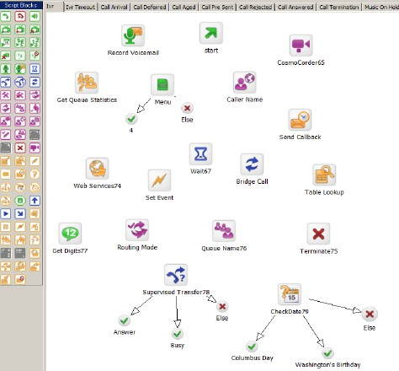
Designer
A browser based graphical tool for call and IVR flow creation
No programming “drag and drop” interaction flow creation
Create all logic around menus, conditional branch, access external data sources
Call control logic, answer, transfer, hang up

Slide 62

GLCCaaS Open Application Interfaces (APIs)
GLCCaaS Platform provides open interfaces to service providers and tenants for easy customizations and integrations to:
  CRM, ERP and desktop based application integrations
    Client side and central server based integration options
  Self-service applications and IVR systems
    Speech recognition, Text-to-Speech, Virtual assistants and Chatbots
  Intelligent routing and artificial intelligence engines
  Unified Communications, PBX and Skype4Business integration
  Business intelligence and analytics tools
  Workforce management and optimization tools
    Speech analytics and quality monitoring
  Unified Desktop and workflow scripting
  Operational network management tools

Slide 63
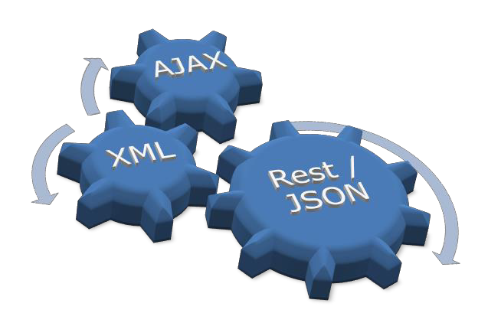
GLCCaaS Open Application Interfaces (APIs)
TouchPoint (client) interfaces
Adaptability with expandable gadget framework
Connector for .NET and JavaScript
AJAX API for all call events and controls
Central Integration Server
Server based integration connector (REST / JSON) for application integrations
Routing Scripts
Call XML scripts with standard integration blocks to web services, databases and MRCP

Slide 64
GLCCaaS Open Application Interfaces (APIs)
Administration API
SOAP 1.2 based interface for tenant administration tasks
Single Sign On
SAML 2 support to ADFS
Operational management
SNMP traps, windows events and performance counters

Slide 65
BENEFITS AT A GLANCE

Slide 66
FEATURES AT A GLANCE

Slide 67

By Phone 1.833.800.GLCC
By Email info@glcloudconnect.com
Or visit our website www.glcloudconnect.com

Slide 68


